Slide 1
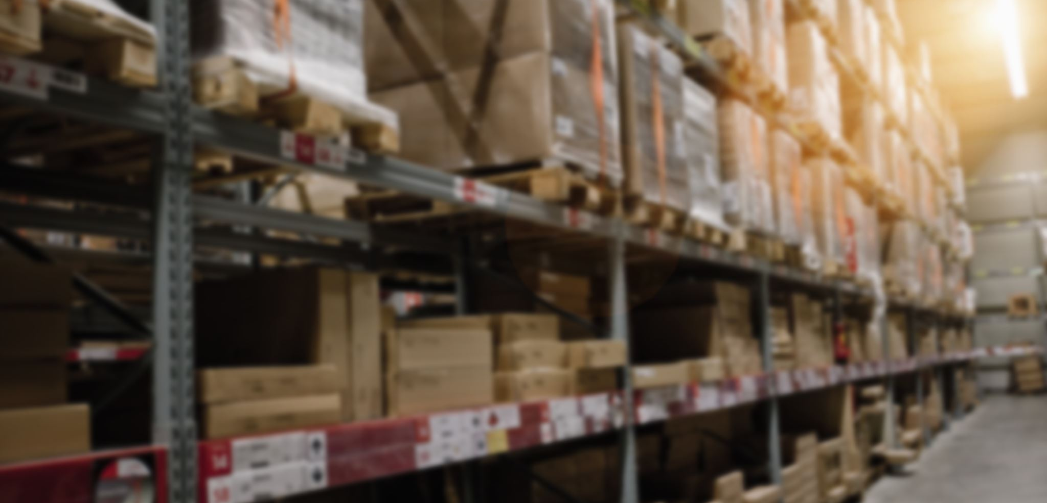
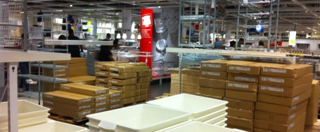
Inventory

Slide 2
Purchase order process flow
No
Align with the commercial team to adjust the PO
Purchase Order creation “ PO “
Top management approval
Goods Received
Quantity matching with the PO?
Yes
Operation inbound - Delivery Note “ DN “
Vendor invoice received
Three-way matching
Invoice = PO & DN?
Invoice recording
Yes
Vendor payment
Align with the vendor to adjust the invoice
No

Slide 3
Inventory accounting controls definition
Inventory accounting control is a set of procedures and processes that are designed to ensure that a company's inventory is accurately recorded, valued, and reported in its financial statements.
Effective inventory control helps to manage the company's working capital and ensure that it has enough inventory to meet customer demand while avoiding overstocking and excess carrying costs.
Businesses should have a system in place to track their inventory, including the quantity of each item, its location, and its status (e.g., in transit, in stock, sold, etc.)
businesses must value their inventory correctly on their financial statements, by deciding one of the inventory methods that best fit the business needs and accounting requirements.

Slide 4
Inventory Controls
Warehouse space: The commercial team should align the warehouse space availability with the operational team before requesting any purchase order to Avoid overstocking. Overstocking can lead to increased storage costs, decreased efficiency in the warehouse, and potential damage to the goods.
Inventory Count and inspection: The operation team should count and inspect all the incoming inventory to make sure that they received the right quantity matching with the PO, the correct type of products and they aren’t damaged before recording them as “Inbounded”. All items that fail inspection should be returned at once.
Delivery note: Operation team to issue and sign a delivery note for all products received and share a copy with their finance team.
Inventory record: The finance team to apply the 3-way matching method while recording the inventory in the financial system, they need to make sure that the PO created by the commercial team is matching the delivery note issued by the operation team and matching the invoice received by the supplier, in case of discrepancies they need to communicate the supplier to flag and solve the issue.

Slide 5
Inventory Controls
Regular physical counts: Businesses should conduct regular physical counts of their inventory. This involves physically counting each item and comparing the count to the inventory records in the financial systems.
Inventory removal: The operation team should align with finance before any inventory removal and sign off a report that includes a list of UIDs, dates, and reasons for removal.
Inventory returns: Operation team to align with the finance team before proceeding with any returns to avoid any debit balances from the vendors’ side.
Inventory internal reporting: Finance should share some reports with the commercial and operational teams so they can control and monitor the slow-moving items, and the total losses/damages on a regular basis.
Yearly cycle count: Businesses must conduct a physical cycle count at the end of the financial year to ensure that the inventory records in the financial statement accurately reflect the physical inventory on hand.

Slide 6
Inventory Accounting cycle
Goods received from the vendor “ Inbound”
Cost of goods sold “Outbound”
DR
Inventory
DR
COGS
CR
Inventory Accrual
CR
Inventory
Invoice received from the vendor “ 3-way matching”
Lost inventory items “Cycle count”
DR
Inventory Accrual
DR
Inventory write-off expense
CR
Vendor
CR
Inventory
Vendor payment
Write-down inventory “Slow moving items”
DR
Vendor
DR
Inventory write-down expense
CR
Bank
CR
Inventory

